Slide 1
Python Project Google Search Module
By Abhishek Divekar, March 2016, V.J.T.I. College, Mumbai

Slide 2
Current Scenario:
Many applications require large amounts of data which can be queried from search engines with specific criterion, e.g.
A large database of newspaper articles from specific sites.
Research for scientists on thousands of different sources found most easily via IEEE etc. (these sites offer a search feature but it is not as powerful as Google)
Thousands of user profiles on Facebook/LinkedIn for market research.
Trend tracking: The top 100 or 200 daily results for “Best Biryani Mumbai” or several other such queries can be tracked daily. Social media can also be tracked.
Constant updates on flights, advertisements, analytics etc. which form a part of Google’s service APIs.
Many search engines / SEO sites query Google and other search engines very frequently, checking their ranking and the ranking of their competitors. Search engines also pay for/steal results from Google.

Slide 3
Current Solutions I:
Python is a simple prototyping language, often used to build small websites and projects.
Google has a Python API:
Advantage is that it is direct from Google, and very light in terms of bandwidth as only results are sent.
Difficult to use (not plug-and-play). Complicated code is required, causes large overhead to learn.
Need to implement Google’s SOAP API.
Has excessive options, which cause confusion.
Only allows 1000 free queries per day. After that, the price increases to $50 per 1M queries.
Have to enter contract with Google.
Suitable for large software-oriented business projects, but not for small projects or non-programmers who require large amounts of Google Search results (such as market data).

Slide 4
Current Solutions II:
Small Python scripts which use web-scraping on Google’s results page:
Offer few options for programmer as they are very basic scripts.
Involves large amount of manual work, e.g. usually the query itself must be entered manually for every query.
Often improperly packaged and cannot be used by other Python modules.
Usually, the script queries the results too fast, and as a result Google blocks the user’s IP temporarily.
This becomes very tedious because the user must wait for the IP to get unblocked, thus increasing the amount of manual effort expended.
Also, the next time the script is run, if the speed it not decreased then Google blocks the IP after very few results (~30).
Some IPs eventually get ‘burned’.

Slide 5
The best solution…GoogleSearch.py
An open-source Python package that allows programmers, or even non-programmers to get large amounts of Google Search results from an easy-to-use, one-click interface.
The package does not cost any money, and allows us to access tens of thousands of results per day while circumventing Google’s IP-blocking techniques.
The user does not have to do anything except enter the parameters, sit back and watch as results are collected.

Slide 6
Cost-saving metrics:
Cost of normal Google Python API is $50 per 1M results.
VPN solution:
VPN’s cost ~$5 per month, and the right service can offer hundreds of IP addresses for use.
Assuming cost is $5/month, and 100 IP addresses are offered, at the rate of 10,000 results per IP per day, we can get around 1M results per day, every day of the month.
That means, costs us 5/30 = $0.16667 per 1M results using GoogleSearch.py.
This is a 150 times cost saving as compared to the Google API.
There is some overhead in switching IP addresses; at present, virtual machines or multiple sockets must be used with this solution. A solution that switches IPs using multiple threads is currently being proposed.
A similar effect to the VPN can be achieved using a cluster.

Slide 7
System requirements
Software requirements:
Any operating system (Windows, Linux, OSx) that supports Python.
Python 2.7.x (Python3 is not used mostly because of the package dependencies).
Python packages:
Jdcal
BeautifulSoup
“Splinter” or “twill” browser handler (this dependency is being phased out, and soon neither will be required).
Hardware requirements:
Can run on basically any hardware.
If Virtual Machines are used, usually about 500 MB RAM per VM.

Slide 8
Features offered Control of service:
The application at present offers a full-featured command-line interface similar to that of the Linux terminal.
Help feature is included, along with tips.
Can use -p, --insert_search etc., followed by the argument, in any order.
You can pause, exit, continue etc. while the results are being extracted with Ctrl+C.
You can choose whether to insert the results by page or by search.
You can get results in a staggered fashion, e.g. you want the Google Search results for the last 5 years, but you want to check only for results that appear in certain months, without entering the months manually. This is particularly useful for extracting news articles.
You can select which database to use and the table name in that database.

Slide 9
Features offered Versatility of search:
User-modifiable parameters:
All the following can be set by the user for their Google Query:
Google Domain
Necessary words
Fuzzy words
Site lists
Inurl word
Daterange
Number of results per page can be modified:
increases the speed significantly
Must have larger wait-times between pages

Slide 10
Features offered Versatility of search:
User-modifiable parameters:
Staggered results (i.e. over multiple periods of time).
Results per time period
Number of time periods
(Optionally) the date to force resume from (otherwise, it checks the database automatically and resumes from where you last left off).
Waiting time can be set manually (otherwise, it uses best estimates):
Wait time between pages
Wait time between searches
Insert results by page or by search:
By page is the default behaviour as no data is lost if the next page fails.

Slide 11
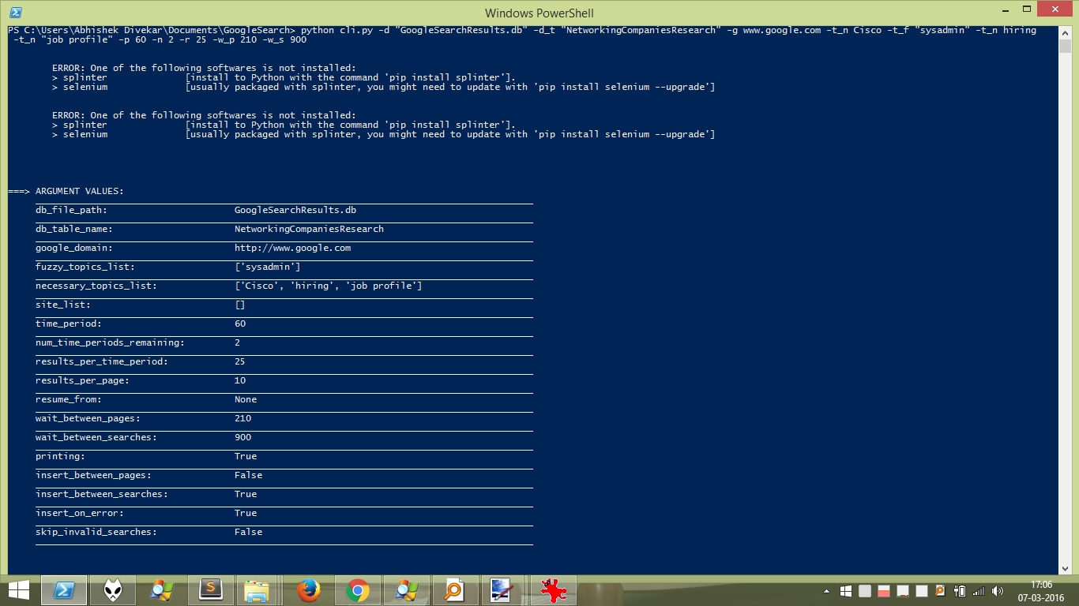
Example

Slide 12
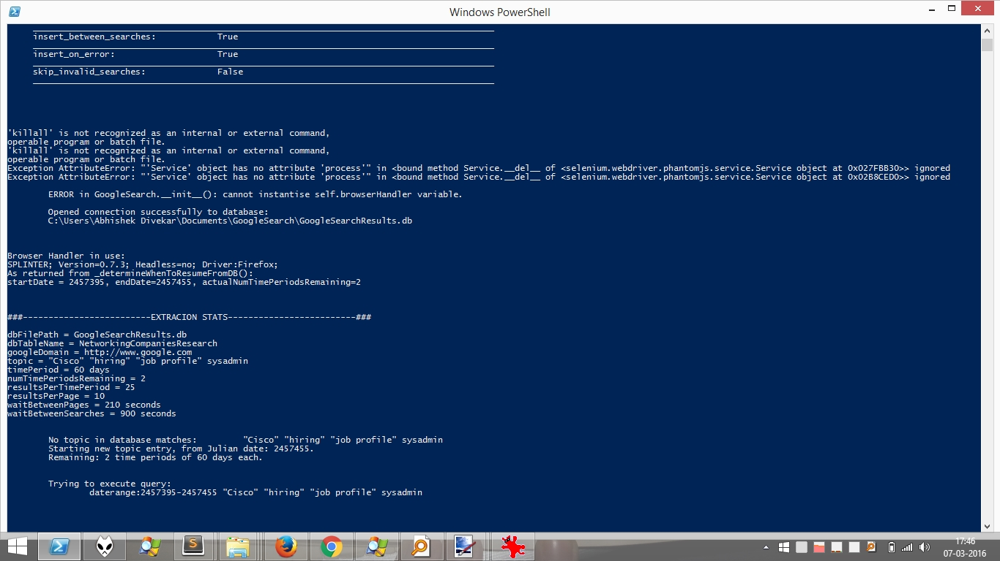

Slide 13
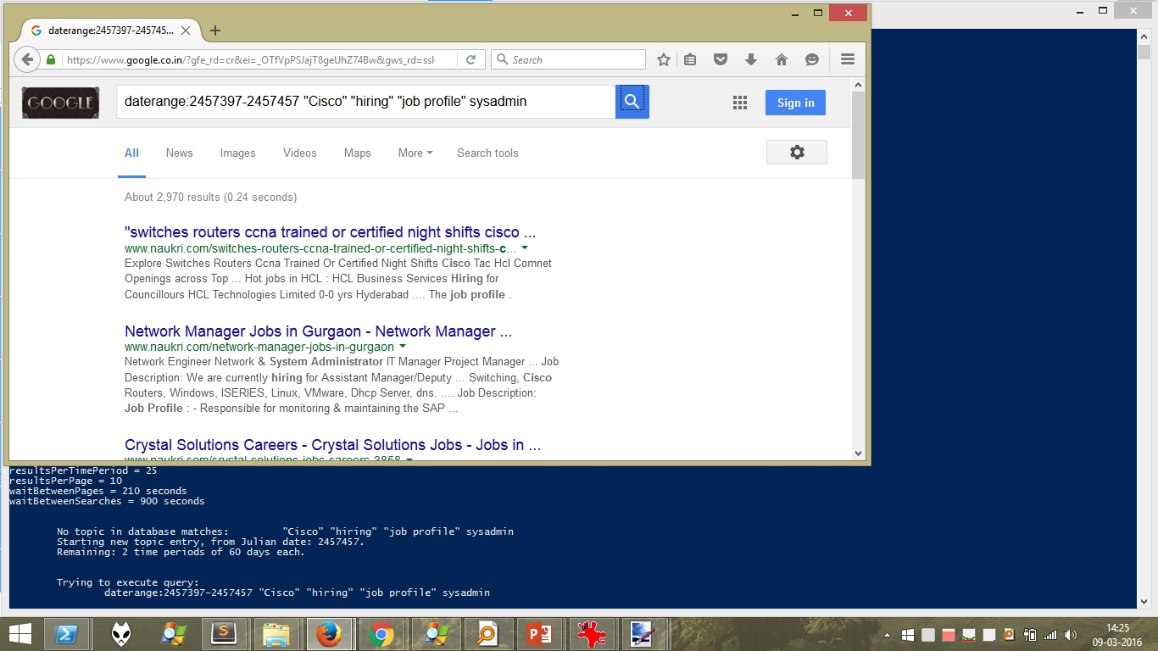

Slide 14
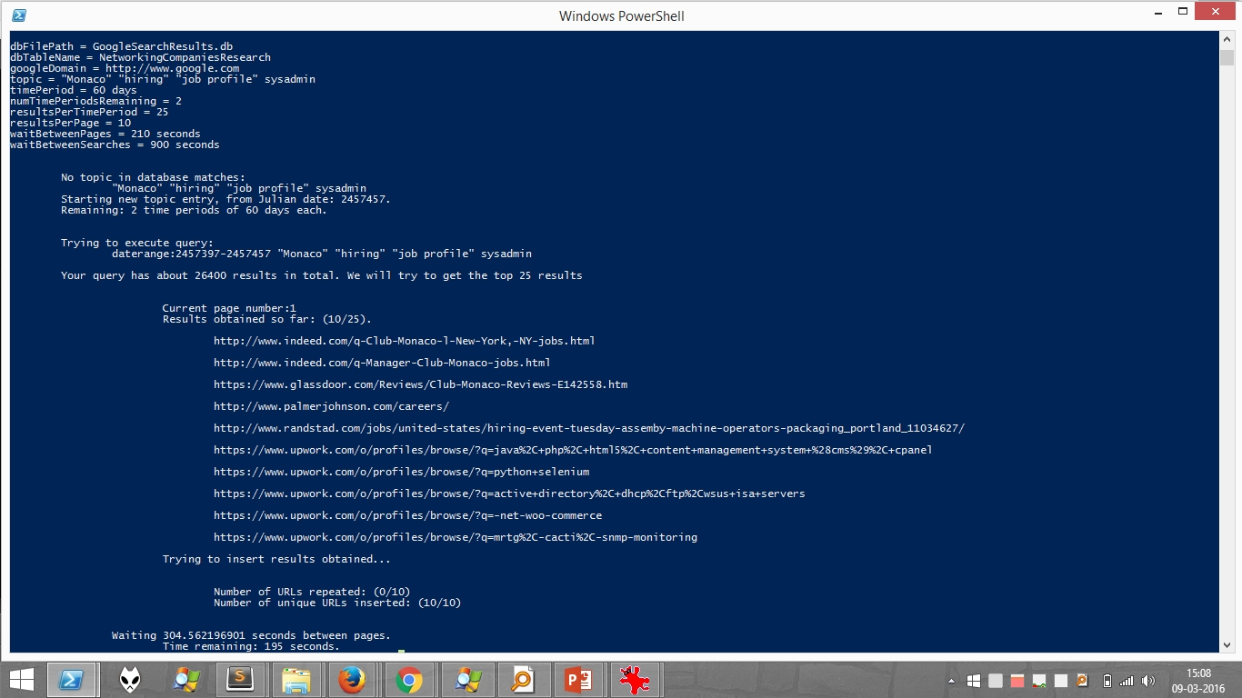

Slide 15
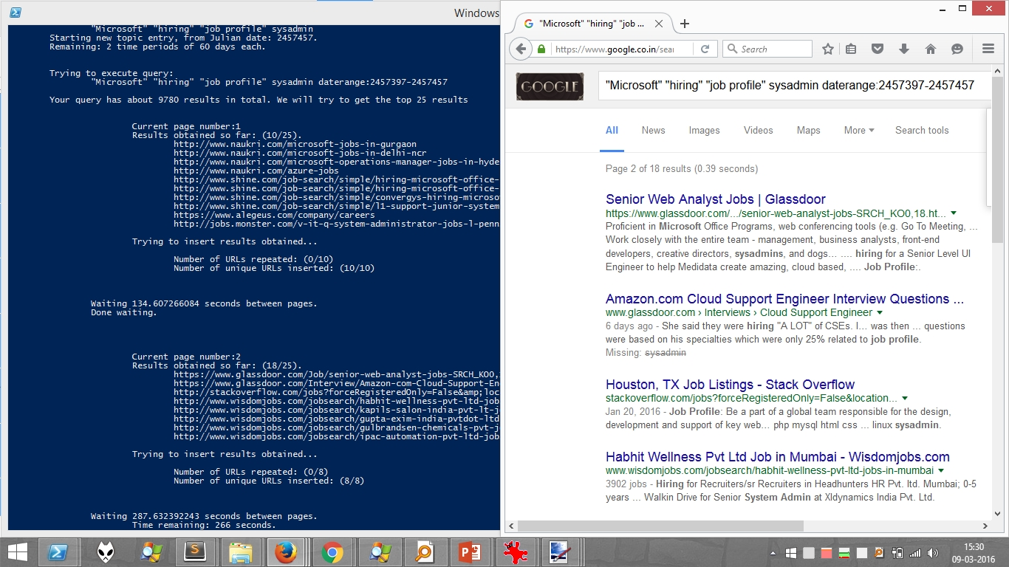

Slide 16
Advantages offered:
Simple interface, plug-and-play:
Works as an independent application as well as a Python package for developers.
Results are saved either as an SQLite database, or sent directly to the calling function as a tuple.
Several options for use, queries can be modified in very versatile ways and built from the ground-up. Staggered (i.e. time-variant) results are also possible.
Absolutely free results:
Up to 10,000 results per day, per IP address.
Source code available for view on GitHub:
https://github.com/ARDivekar/googlesearch_article_url
To get more results, you can use a VPN (~$5 per month).

Slide 17
Advantages offered:
NO MANUAL WORK:
The process is completely automated, the user only needs to set the wait-time between pages and searches. This removes the biggest problem present in simple webscraping scripts.
We can also query much faster by simply setting the wait-time between pages or searches to a smaller value (this is not recommended as doing it below the recommended rate causes Google to block your IP. A warning is shown to the user if the wait-time is below the empirically-estimated threshold).
The computer must be left on overnight, which is most useful for servers which are active 24/7.
Uses little bandwidth:
This is the same as for other screen-scraping methods. Estimated 15 MB per 10,000 queries when retrieving 100 results per page.
SQLite databases are highly portable:
Just copy the file.
Data can be viewed via software like SQLite browser.

Slide 18
Advantages offered Robustness:
Supports multiple browser handlers like Twill, Splinter, etc.
User can request a particular browser handler, otherwise default is used.
If requested browser handler is not available, it tries ALL supported to see if any are available (with the introduction of NoBrowser, it is guaranteed that something will work).
Can easily be extended to other search engines like Bing, DuckDuckGo, etc.
Can be done as code is highly modularized.
Warnings are given to the user if the wait-times are below the threshold.

Slide 19
Future of the project:
Since it is open source, anyone can contribute.
Visit https://github.com/ARDivekar/googlesearch_article_url and make a branch.
Features left to contribute:
More search engines:
Currently it is only Google, but due to high cohesion, can easily add Bing, DuckDuckGo, etc.
Search engines can be queried in parallel as they all block IPs independently.
Thus, the time gets cut down even more.
Better IP-circumvention:
Goal is to remove need for any user intervention when IP is blocked, etc.
IP-switching is currently manual via VPN, can be automated.
Might use backoff algorithms similar to TCP-Tahoe to automatically increase the wait-time when one request has been denied.
Statistics can be collected, and a Machine Learning classifier can be trained to determine optimal wait-time.

Slide 20
Future of the project:
Features left to contribute:
GUI:
Currently it is command-line only, but GUI can be very useful for non-developers.
User settings can be saved between sessions.
Progress can be seen graphically and paused, resumed etc.
NoBrowser:
Without any browser handler, dependency on Splinter and Twill is removed.
Tricky problem, as converting Google queries to URLs is not easy (Google uses hashing mechanisms, etc which must be replicated).
It will be a default fallback option that always works.
Exporting to pip / easyinstall:
Can be installed from the servers directly.
Can include other packages inbuilt as they are all open-source.
Further modularization

